Slide 1
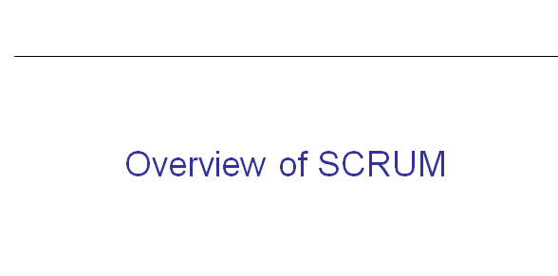

Slide 2
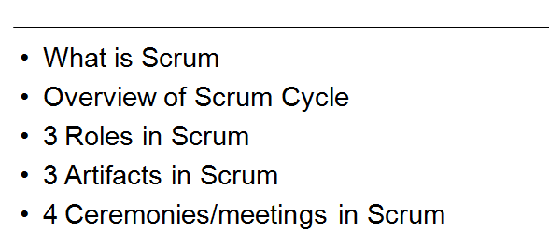
Agenda

Slide 3
What is Scrum
Scrum is a lightweight agile project management framework mainly used for software development. It describes an iterative and incremental approach for project work.

Slide 4
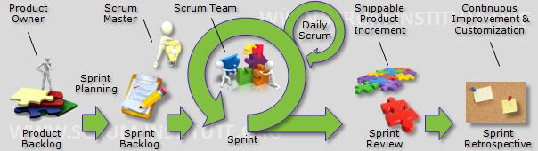
What is Scrum

Slide 5



Scrum origins
Jeff Sutherland
  Initial scrums at Easel Corp in 1993
  IDX and 500+ people doing Scrum
Ken Schwaber
  ADM
  Scrum presented at OOPSLA 96 with Sutherland
  Author of three books on Scrum
Mike Beedle
  Scrum patterns in PLOPD4
Ken Schwaber and Mike Cohn
  Co-founded Scrum Alliance in 2002, initially within the Agile Alliance

Slide 6
Scrum has been used by:
Microsoft
Yahoo
Google
Electronic Arts
High Moon Studios
Lockheed Martin
Philips
Siemens
Nokia
Capital One
BBC
Intuit
Intuit
Nielsen Media
First American Real Estate
BMC Software
Ipswitch
John Deere
Lexis Nexis
Sabre
Salesforce.com
Time Warner
Turner Broadcasting
Oce

Slide 7
Scrum has been used for:
Commercial software
In-house development
Contract development
Fixed-price projects
Financial applications
ISO 9001-certified applications
Embedded systems
24x7 systems with 99.999% uptime requirements
the Joint Strike Fighter
Video game development
FDA-approved, life-critical systems
Satellite-control software
Websites
Handheld software
Mobile phones
Network switching applications
ISV applications
Some of the largest applications in use

Slide 8
Characteristics
Self-organizing teams
Product progresses in a series of month-long “sprints”
Requirements are captured as items in a list of “product backlog”
No specific engineering practices prescribed
Uses generative rules to create an agile environment for delivering projects
One of the “agile processes”

Slide 9
Sprints
Scrum projects make progress in a series of “sprints”
  Analogous to Extreme Programming iterations
Typical duration is 2–4 weeks or a calendar month at most
A constant duration leads to a better rhythm
Product is designed, coded, and tested during the sprint

Slide 10





Scrum
24 hours
Sprint
2-4 weeks
Sprint goal
Return
Sprint backlog
Potentially shippable
product increment
Return
Cancel
Gift wrap
Coupons
Gift wrap
Cancel
Coupons
Product
backlog

Slide 11

Putting it all together
Image available at www.mountaingoatsoftware.com/scrum

Slide 12

Scrum framework
Roles
Product owner
ScrumMaster
Team
Ceremonies
Sprint planning
Sprint review
Sprint retrospective
Daily scrum meeting
Artifacts
Product backlog
Sprint backlog
Burndown charts

Slide 13

Product owner
Define the features of the product
Decide on release date and content
Be responsible for the profitability of the product (ROI)
Prioritize features according to market value
Adjust features and priority every iteration, as needed
Accept or reject work results

Slide 14

The ScrumMaster
Represents management to the project
Responsible for enacting Scrum values and practices
Removes impediments
Ensure that the team is fully functional and productive
Enable close cooperation across all roles and functions
Shield the team from external interferences

Slide 15





The team
Typically 5-9 people
Cross-functional:
  Programmers, testers, user experience designers, etc.
Members should be full-time
    May be exceptions (e.g., database administrator)

Slide 16
The team
Teams are self-organizing
  Ideally, no titles but rarely a possibility
Membership should change only between sprints

Slide 17

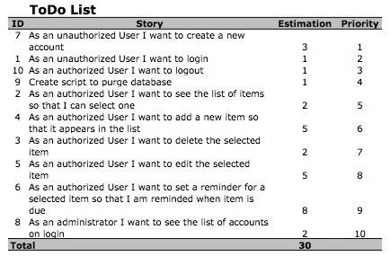
Product Back Log

Slide 18
Product Back Log
Each Scrum Product Backlog has certain properties that differentiate it from a Requirement Document:
an entry in the Scrum Product Backlog always add value for the customer
the entries in the Scrum Product Backlog are prioritized and ordered accordingly
the level of detail depends on the position of the entry within the Scrum Product Backlog
all entries are estimated
the Scrum Product Backlog is a living document
there are no action-items or low-level tasks in the Scrum Product Backlog

Slide 19
Sprint Back Log
Sprint Backlog containing all items that could be fully implemented until the end of the Sprint.

Slide 20
Burn Down Chart
The Sprint Burndown Report shows the progress within the Sprint toward reaching the Sprint Goal. It provides transparency about the current performance (burndown rate) and allows easy estimation if the Sprint Goal can be reached in time or if the team has to find additional measures to speed-up completion of the remaining activities.

Slide 21
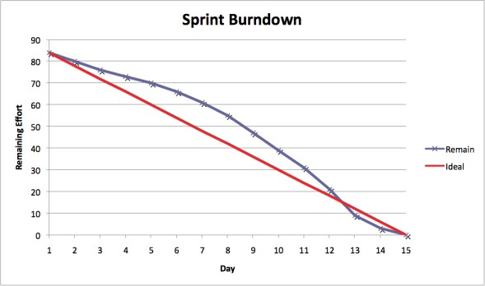
Burn Down Chart

Slide 22
Sprint Planning Meeting
Roles
  Primary Performer: Scrum Team
  Additional Performers: Product Owner and Scrum Master
Inputs Mandatory: Product Backlog
Optional: None
Outputs: Sprint Backlog

Slide 23
Sprint Planning Meeting
Main Description
The Sprint Planning Meeting is attended by the Product Owner, Scrum Master, the entire Scrum Team, and any interested and appropriate management or customer representatives.
During the sprint planning meeting the product owner describes the highest priority features to the team. The team asks enough questions during this meeting so that they can go off after the meeting and determine which tasks they will move from the product backlog to the sprint backlog.
Collectively, the Scrum team and the product owner define a sprint goal, which is a short description of what the sprint will attempt to achieve.

Slide 24
When Agile ?
Agile methods are used when these conditions are present:
project value is clear;
The customer actively participates throughout the project;
The customer, designers, and developers are co-located;
Incremental feature-driven development is possible;
Visual documentation (cards on the wall vs. formal documentation) is acceptable.

